Slide 1
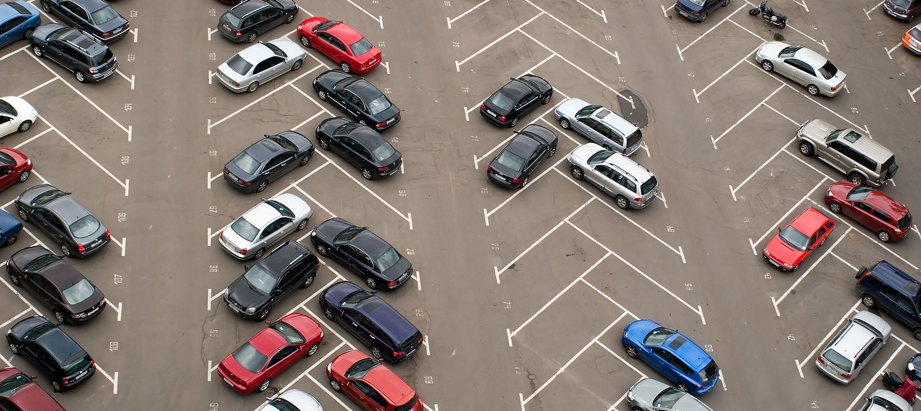
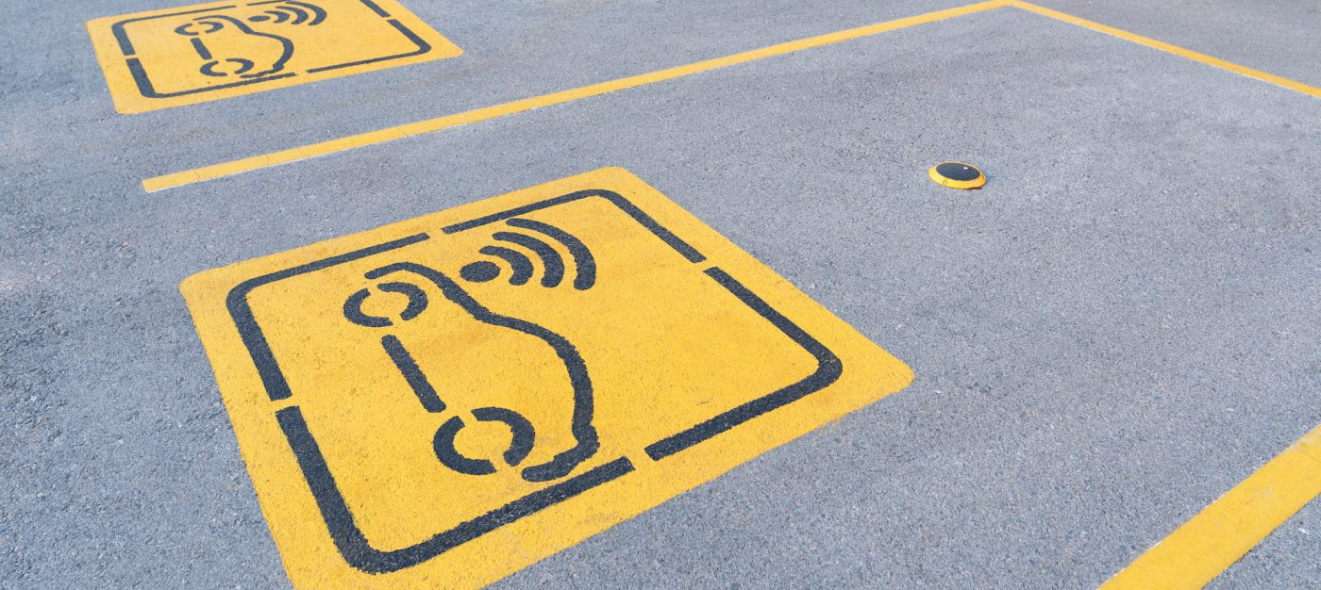

Welcome-To ParkUrWheels
Team Unplugged Techies

Slide 2

Team Members
Inzamul Hoque.
Shubham Kamble.
Snehal Gugale
Sujit Kharat.
Rajesh Pandhare.
Team Unplugged Techies

Slide 3
Overview
The main objective of parking system is to manage the details of duration , Vehicles ,Parking Slots , Customer and Parking Fees.
The objective of our hackathon topic is to automate and simplify parking slot concern.
With the use of high accuracy latest industry sensors to get run-time parking status.
Team Unplugged Techies

Slide 4

Why ParkMyWheels
Struggle-Free finding safe and nearby parking slot.
Get Real-time live data for available parking slots.
Pre-Book parking slot and Rent/List own parking slot.
Team Unplugged Techies

Slide 5
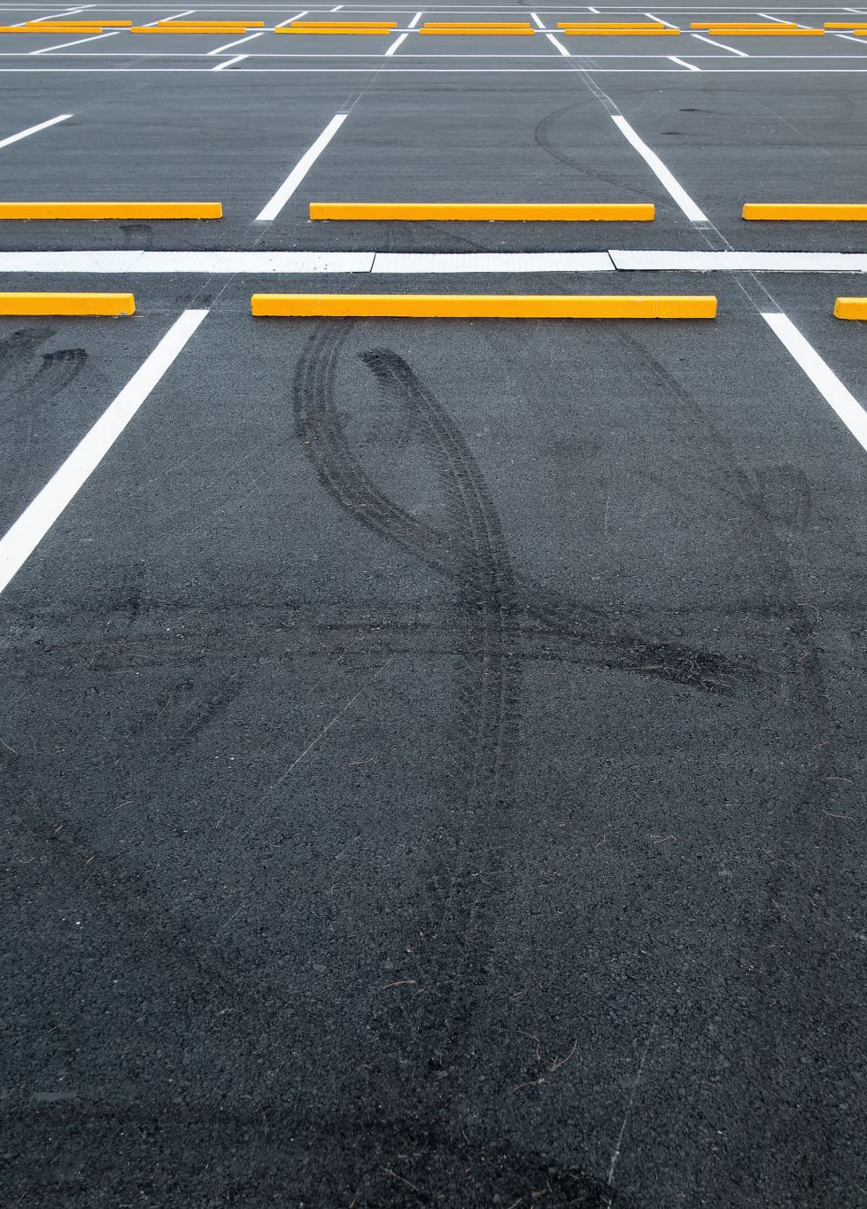
ParkUrWheels Features
Check nearby available parking slots.
Compare fare among nearby available parking slots.
Shows Way to parking slot.
Advance parking slot booking.
To get real-time status.
Team Unplugged Techies

Slide 6
System Design
Platform
Database
Front-End
Back-End
Application Flow
Team Unplugged Techies

Slide 7
Application Flow
Team Unplugged Techies

Slide 8
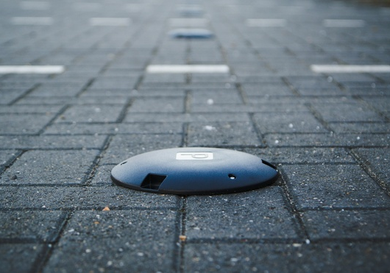
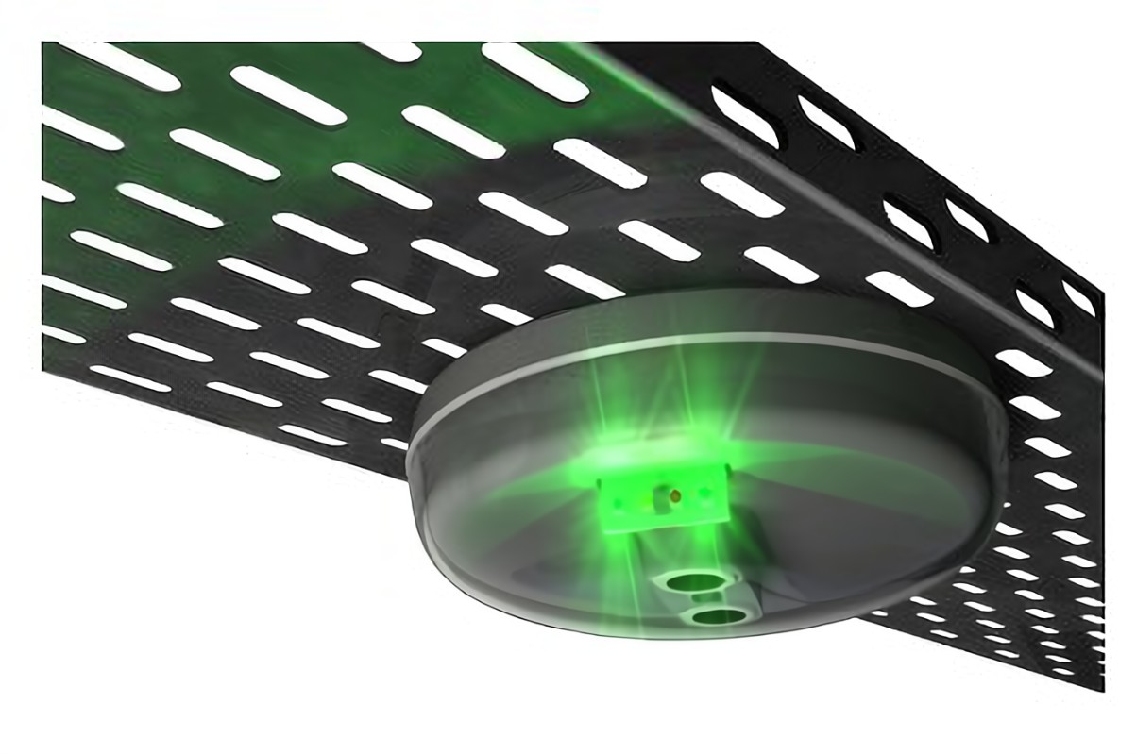
Parking Sensors
Team Unplugged Techies

Slide 9
Sensors work flow
A sensor detects a parked car by measuring the distance to the nearest obstacle-in our case, to the bottom of the car. The state can be “occupied” if the distance is in the range of 100mm – 500mm, “free” if the distance is more than 500mm and “dirty” if the distance is less than 100mm, which means that the sensor may be unclean and needs checking.
Team Unplugged Techies

Slide 10
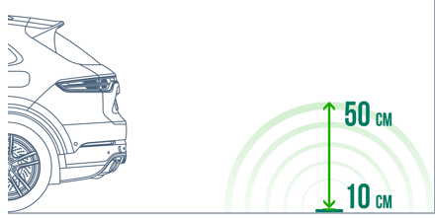
Team Unplugged Techies

Slide 11
Parking Sensors
1. Surface Mount :
This is more reliable and show real-time events with high accuracy.
2. Overhead Sensor
This is simple , very cost-effective and provide Colour coded LED overhead guidance Indicator and that allow user to see availability of entire rows of parking at a glance.
Team Unplugged Techies

Slide 12
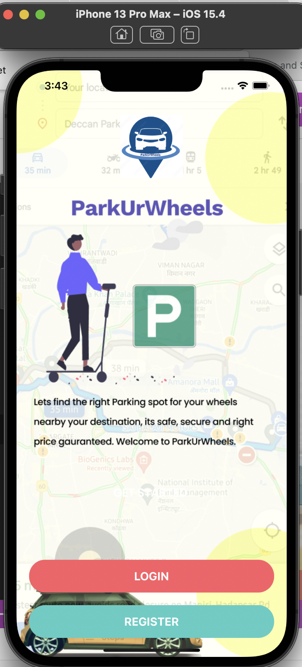
Login Screen

